Slide 1
Clustering Spotify Songs
Group 1
Zhanna Borodaeva
Chen Zheng
Fiorella Carbone

Slide 2
Questions to ANSWER
Are Spotify’s audio features able to identify “similar songs”, as defined by humanly detectable criteria?
Is K-Means a good method to create playlists?

Slide 3
Number of clusters: 20-100
DATABASE
5000
Number of clusters
20 - 100
NUMBER OF SONGS/CLUSTER
50 - 250

Slide 4
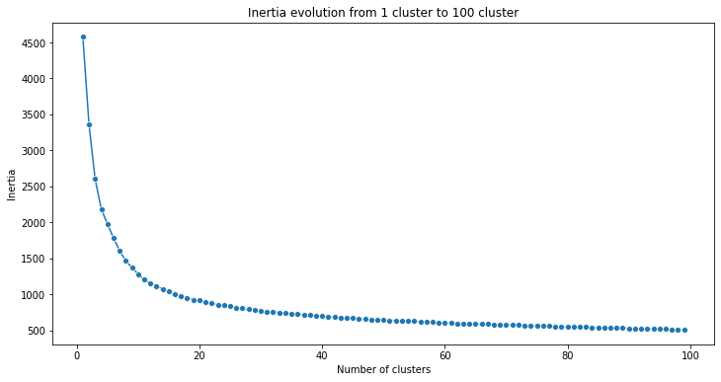
100 clusters: Inflection point at 10 clusters

Slide 5
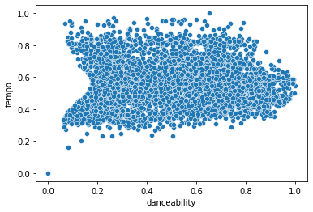
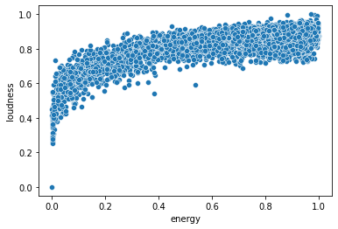
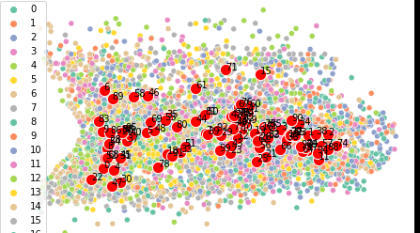
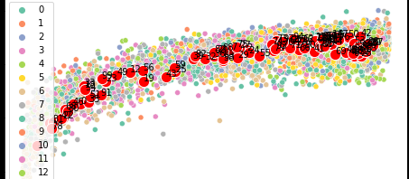
100 clusters: Dots far away from center, Clusters overlap
KMeans = 510.19
Silhouette = 0.14

Slide 6
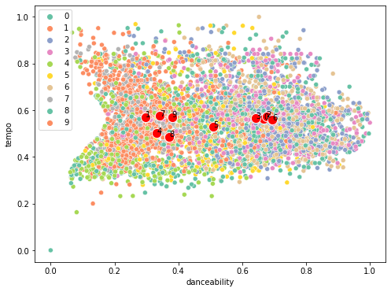
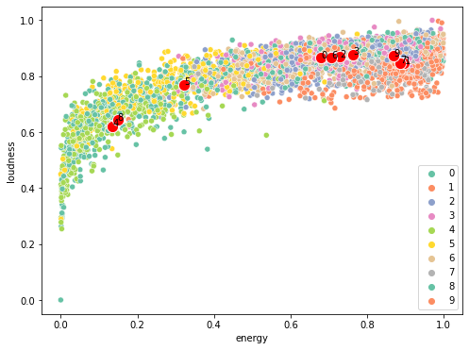
10 Clusters: DISTANCE thrice as much, Clusters may OVERLAp
KMeans = 1283.7
Silhouette = 0.26

Slide 7
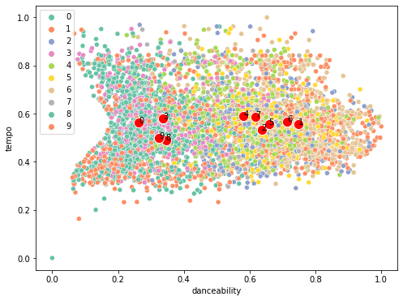
10 Clusters,Deleted: DISTANCE thrice as less, Clusters May OVERLAP
Excluded:
Duration_ms
Time_signature
Acousticness
Instrumentalness
Key
Loundness
Results:
KMeans = 474.5
Silhouette = 0.28

Slide 8
Conclusion
Is K-Means a good method to create playlists?
→ Clusters intersect with each other (Silhouette = 0.3) and inertia is too big (474)
→ No evident differences between the songs per each cluster
K-Means is NOT an appropriate method

